Slide 1

KuruKshetra-25(Hackfest)
Team ID – Team_125
Problem Statement Title – Clean and Green Technology
Domain/Theme – Open Innovation
Team Name – Aqua Shield
Team Leader Name - Nikhil Lanke

Slide 2

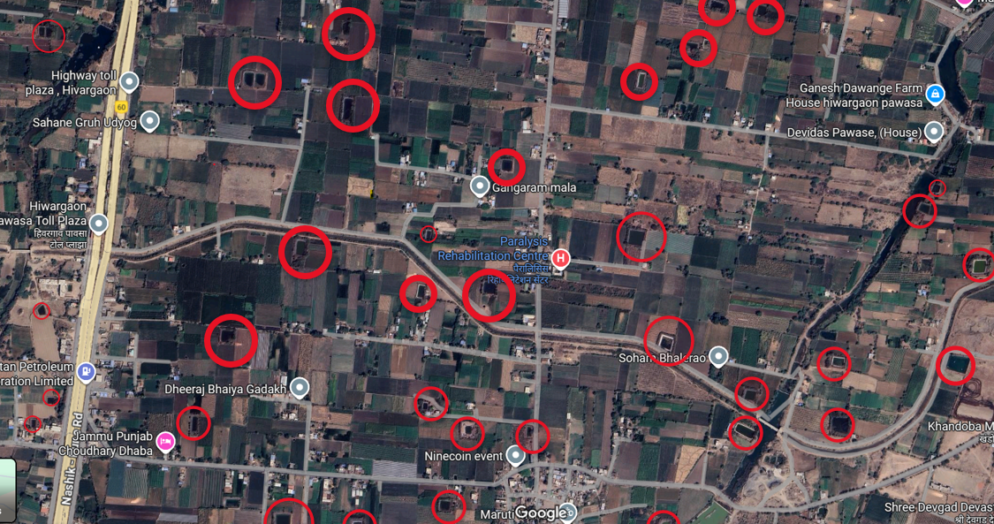
Proposed Solution
As of the latest available data, Maharashtra has over 10 lakh farm ponds. These ponds are crucial for supporting agriculture, especially in regions facing water scarcity.
One of the major issues farmers face is algae formation in farm ponds. Algae reduces oxygen levels in the water and causes contamination, which can affect crop health. Algae mainly develops due to the interaction of sunlight with stagnant water. In addition, water evaporation is another serious challenge that reduces the availability of water for farming.
Farmers currently use some traditional methods to tackle these problems, but each has drawbacks:
To address these challenges, we are proposing a new solution called Aqua Shield.
01

Slide 3
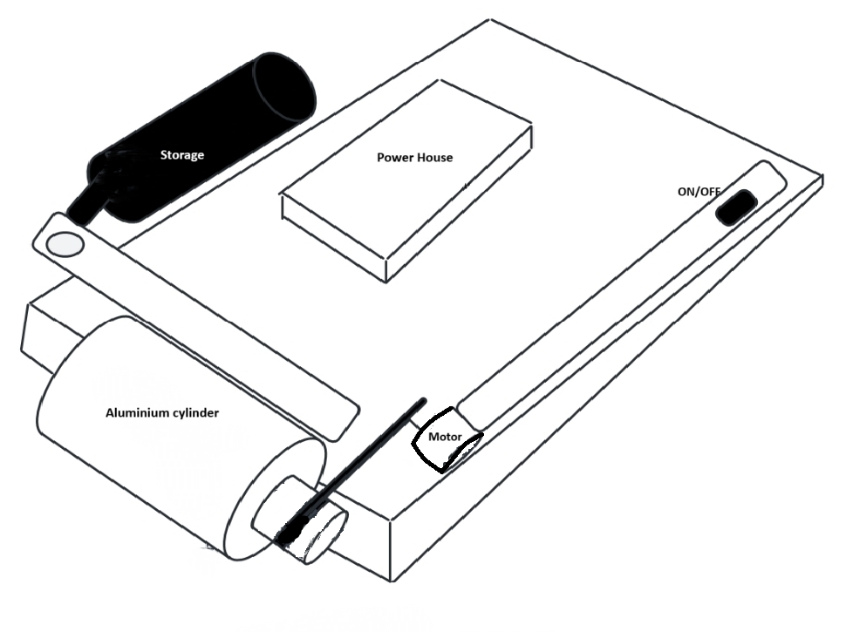
Process flow diagram
Motor rotates cylinder
Oil sticks to cylinder surface
Scraper removes oil from cylinder
Oil collected in storage tank
Working :THE OIL CLEANER
With the power supply the motor will rotate the aluminum cylinder.
The oil in the water gets stuck to the cylinder.
The collector scrapes the oil from the aluminum cylinder, and the oil is directed to the storage tank.
02

Slide 4
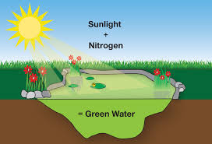
Methodology used
In our village, we have a farm pond. To reduce and stop algae formation, we tried several traditional methods:
Fish farming: Fish eat algae, but their waste makes the water dirty and affects its quality.
Thin plastic sheets: These sheets get torn by the sun and are easily blown away by the wind.
Fertilizers: While they can kill algae, they also contaminate the water and harm agriculture.
All of these methods had more disadvantages than benefits.
Between 2015 and 2018, we tried another method:
applying a thin layer of oil on the surface of the pond. This helped block sunlight and reduce algae growth. However, we faced a big problem—we didn’t know how to collect the oil back from the water once it spread.
To solve this, we designed a mechanism that can separate and recollect the oil from pond water, making the process more effective and sustainable.
Algae
03

Slide 5
Solution Concept and Feasibility
Solution Concept :
The solution, Aqua Shield, tackles algae formation and water evaporation in farm ponds by using a thin oil layer on the water surface.
The oil blocks sunlight, preventing algae growth, while being non-contaminating and reusable.
An oil cleaner device with a motor-driven aluminum cylinder collects and stores the oil, making the system sustainable and efficient.
This approach minimizes water loss from evaporation and ensures healthier water for farming needs
Feasibility :
Technical Feasibility
Economic Feasibility
Environmental Feasibility
Operational Feasibility
Long-term Viability
04

Slide 6
Use cases & Description
Use Cases :
Farm Ponds in Villages
Prevent algae formation in small to medium farm ponds.
Reduce evaporation losses to conserve water during drought.
Community Water Storage Tanks
Keep shared water bodies clean and reusable without chemicals.
Encourage collective investment and maintenance by farmers.
Agricultural Irrigation Systems
Maintain water quality for crop irrigation.
Reduce the risk of contamination caused by algae or fertilizers.
Rural Water Conservation Projects
Provide a sustainable method for villages facing recurring water scarcity.
Can be scaled for government or NGO-driven conservation programs.
Description :
Aqua Shield is a clean and green technology designed to control algae formation and reduce water evaporation in farm ponds. The system uses a thin layer of oil that prevents sunlight from reaching stagnant water, stopping algae growth. The oil floats on the surface, does not mix with the water, and can be collected, stored, and reused multiple times with the help of an oil-cleaner device.
The device works by rotating an aluminum cylinder that attracts the oil. A scraper collects the oil and directs it into a storage tank for reuse. This process is non-contaminating, cost-effective, environmentally safe, and easy to use. Farmers can share the equipment at the community level, ensuring long-term sustainability, better crop yields, and water conservation.
05

Slide 7
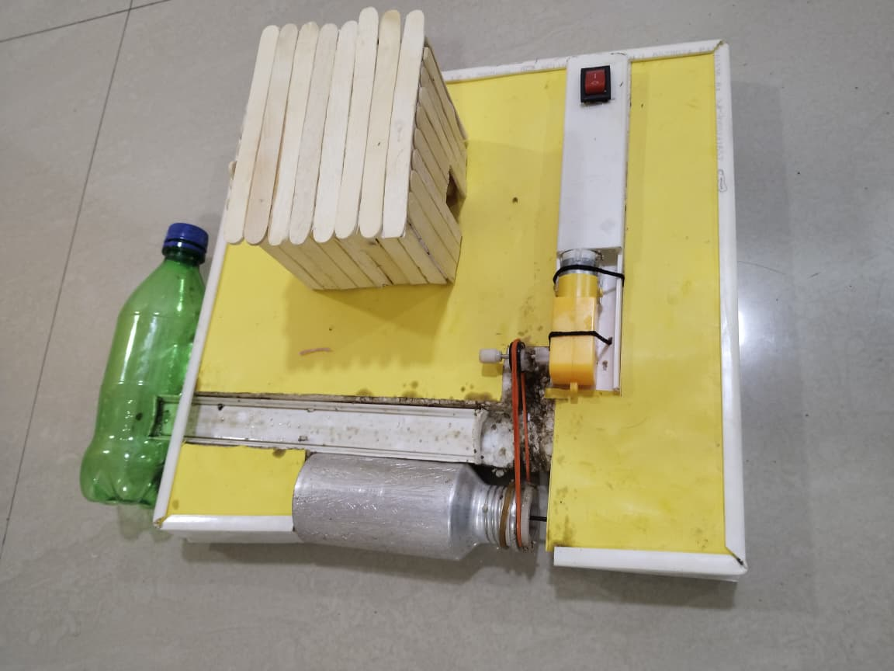
Technology stack used
Mechanical Component:
Aluminum cylinder (corrosion-resistant, long-life span)
Motor (to rotate the cylinder)
Collector and scraper system (to collect oil)
Storage tank (to store reusable oil)
Electrical Component:
Power supply (to run the motor)
Material :
Oil (used as a thin floating layer to block sunlight and prevent algae formation; reusable and non-contaminating)
So, the technology stack is essentially a combination of mechanical design (cylinder, scraper, tank), electrical drive system (motor, power supply), and eco-friendly material (oil).
On/off
. Power supply
Collector
motor
scraper system
cylinder
06

Slide 8
Constraints
Constraints for Aqua Shield
Cost Limitation – Initial setup of the oil-cleaning system and aluminum cylinder must remain affordable for farmers.
Oil Availability – Regular supply of suitable, (black oil), reusable oil is needed.
Maintenance – The motor, cylinder, and scrapers require periodic maintenance to ensure efficiency.
Power Supply – Continuous or reliable electricity may be a challenge in rural areas.
Scalability – Effectiveness may reduce in very large ponds compared to smaller farm ponds.
Environmental Checks – Must ensure the oil used is eco-friendly and does not harm aquatic life.
08

